Slide 1
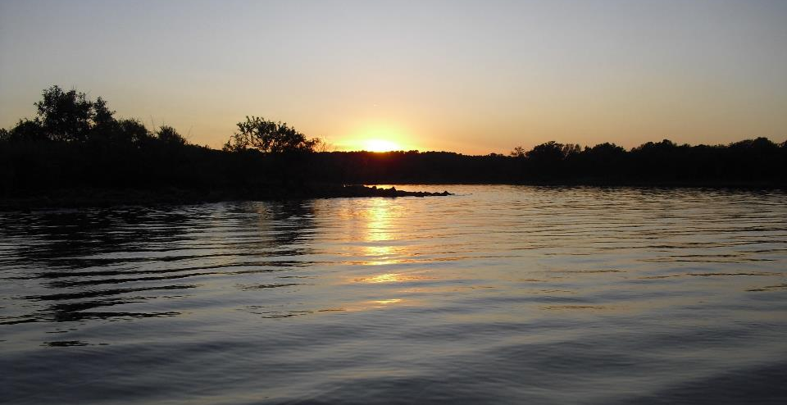
Monitoring Chemistry Basics: pH, DO, Conductivity
GCSA Workshop
OKR04 MCM-3 and Part IV Sampling and Field Methods
Presented by INCOG
Nienhuis Park
May 18, 2022

Slide 2
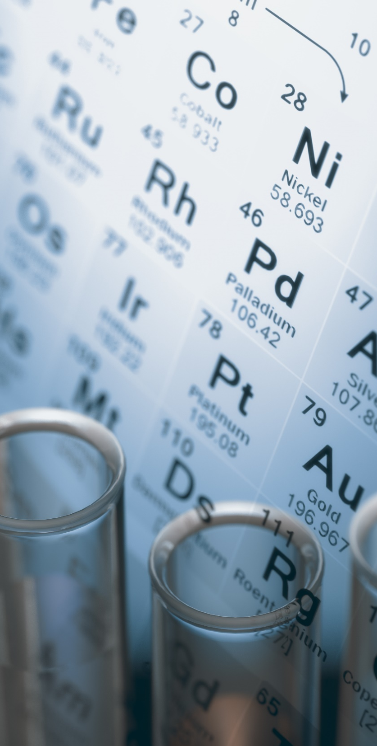
Know Chemistry
Most stormwater program managers have no chemistry background. Others? Maybe 1 course.
Most WQS and concepts of pollution involve chemistry:
Directly as pH, metals and nutrients, or
Indirectly as impacts of pollution such as DO.
Chemistry is fundamental to 303(d), TMDLs and MCM-3 IDDE.
Chemistry education options are difficult.
Another knowledge & education need: biology.

Slide 3
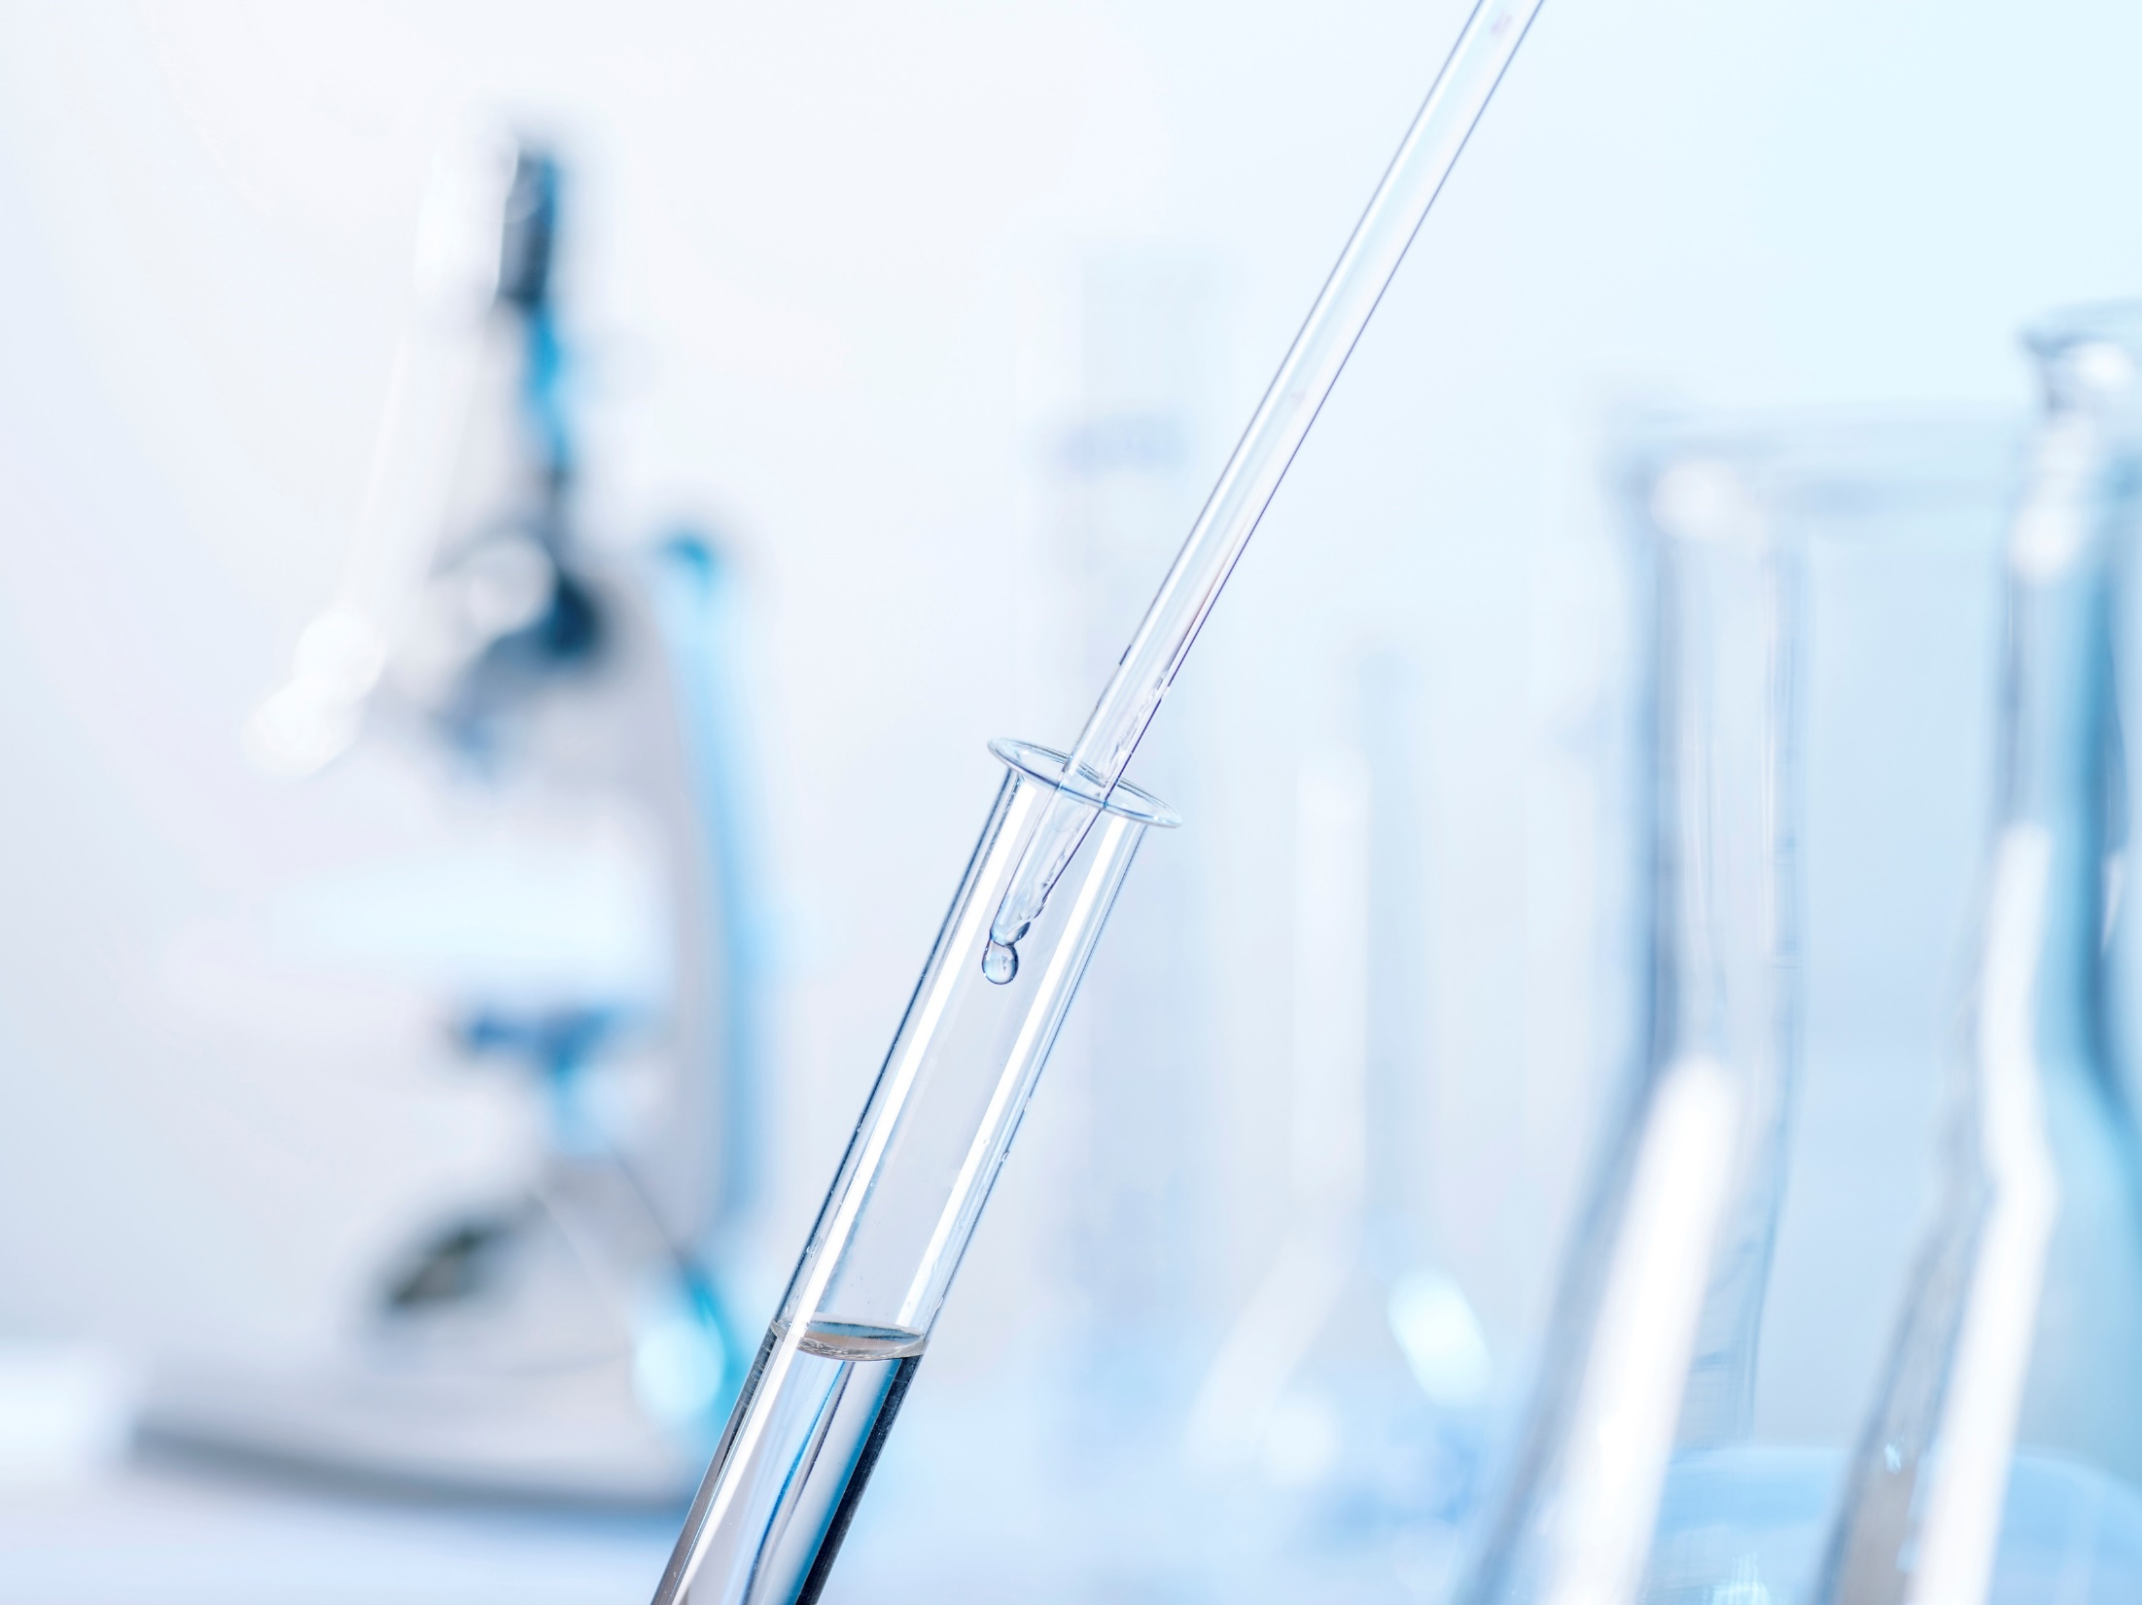
General Pollution Lab Analysis Parameters to Consider
OKR04 doesn’t require specific parameters. These are suggestions:
Bacteria:
E. coli, Enterococcus, fecal coliform *
Genetic marker tests are too expensive.
BOD₅ or CBOD₅
Metals:
Lead, cadmium, copper, zinc, mercury.
Use the lab tests used in WQS Ch. 45.
Solids: Total suspended and total dissolved (TSS and TDS).
* Fecal coliform is no longer in the WQS, but test still may be useful.

Slide 4
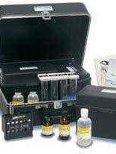
Field Kit Measurements to Consider
OKR04 DOES NOT SPECIFY PARAMETERS. SOME SUGGESTIONS ARE:
pH
Dissolved oxygen (DO) with temperature
Conductivity (be cautious about TDS conversions)
Chlorine residual
Methylene Blue Active Substances (MBAS, surfactants)
Turbidity
Ammonia-N
Nutrients (total nitrogen, total phosphorus, etc.)
Flow (estimate or measure)

Slide 5
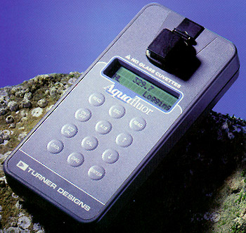
Field Test Kit Considerations
Investigate what test kits you already have:
Review past files, search storage areas, ask around.
Ask to use kits from WWTP and WTP labs.
Make sure your existing kits are still useable:
Age, condition, manufacturer’s support, supplies.
Manuals, instructions, SOPs, or guidance available.
Decide upon what you want; purchase more if needed.
Find a place for proper storage, calibration and repair.
OKR04 does not specify types of screening kits or tests.

Slide 6
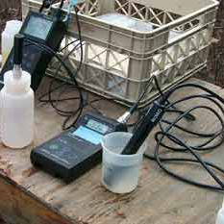
Preparing For Lab Analysis
Train and prepare on how to collect lab samples.
Organize your equipment and supplies.
Pre-select lab services (commercial, agency, city).
Create your written guidance (e.g., SOPs).
Make sure labs know exactly what services you want:
Test methods, detection limits, QA tests, processing.
Supplying containers, labels, preservatives, equip. cleaning.
Lab reports: due dates, content, error corrections.

Slide 7

Chemistry and Monitoring of pH

Slide 8
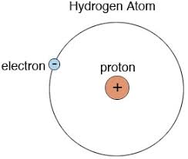
Defining pH
The simplest atom, hydrogen, often gives up its one electron leaving a proton, called a “hydrogen ion” (H⁺).
pH is a measure of the activity of these H⁺ ions (protons).
The mathematical expression is: pH = - log [H⁺]
pH = the negative logarithmic value of the hydrogen ion (H⁺) concentration.
pH affects about every chemical reaction in the Universe, including biological.

Slide 9
The pH Scale
14
(OH⁻)
This is a logarithmic scale. pH values range from 0 to 14.
pH is measured in standard units or s.u.
Each unit increase or decrease represents a tenfold increase or decrease in pH.
A pH of 5 is ten times more acidic than 6 and 100 times more acidic than 7.
Basic (Alkaline)
7
Neutral
Acidic
(H⁺)
0

Slide 10
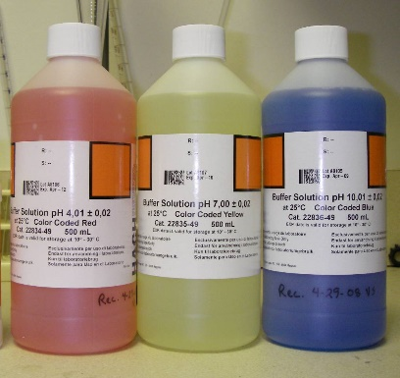
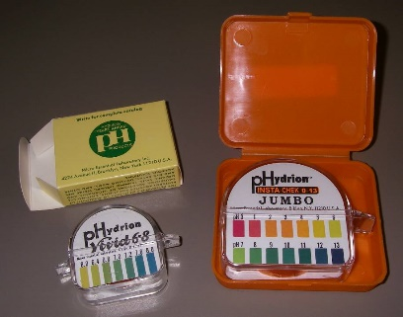
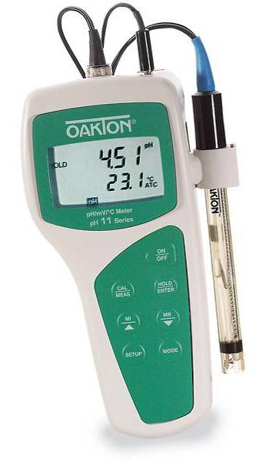

Measuring pH In the Field
Three common field methods:
pH papers
pH “dipstick” pens
pH meters (single or multi-probe)
Calibration: all meters and some pens (at least 2 buffers).
Screening Quality: all papers and pens, some meters.

Slide 11
Collecting a pH Sample
For regulatory purposes, 40 CFR Part 136 methods require:
Container type – polyethylene, fluoropolymer (Teflon®) or glass.
Preservative – none required.
Maximum Holding Time – analyze within 15 minutes.
This eliminates lab analysis of pH for nearly all field samples.

Slide 12
pH of Common Liquids and Solutions
pH | Substance | pH | Substance
14 | NaOH | 6 | Urine, Saliva, Milk
13 | Bleach, Lye | 5 | Black Coffee, Rain
12 | Lime (CaOH) | 4 | Acid Rain, Wine, Beer
11 | Ammonia | 3 | Vinegar (acetic acid)
10 | Tums® antacid | 2 | Lemon Juice
9 | Baking Soda | 1 | HCl in Stomach Acid
8 | Sea Water | 0 | Car Battery Acid, H₂SO₄
7 | Pure Water (Rainfall is ~6.2)

Slide 13
pH Pollutant Source Tracking
Waters of low “alkalinity” (the pH buffering capacity in water) can have a lower pH.
Excess growths of algae can raise pH, often a sign of too many nutrients such as from nitrogen fertilizer.
Industrial chemical spills and illegal discharges and can contain acids or bases that lower or raise pH.
Look for old discarded car batteries at bridge sites; they leak battery acid (sulfuric acid) which lowers pH.
Leaking chemical tanks and material handling areas are common sources of strong acids and bases in runoff.

Slide 14
Chemistry and Monitoring of Dissolved Oxygen (DO)

Slide 15
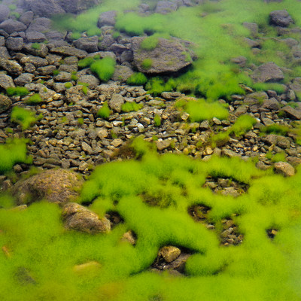
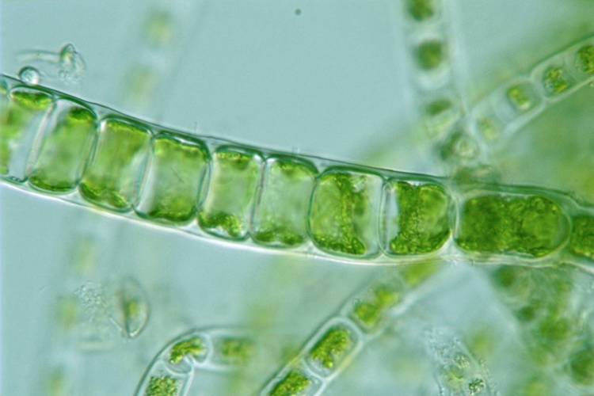
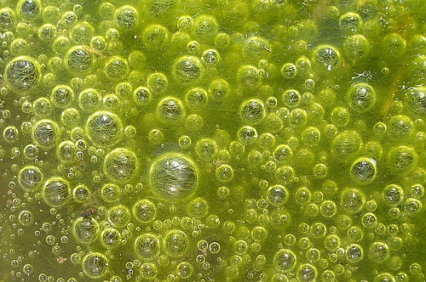
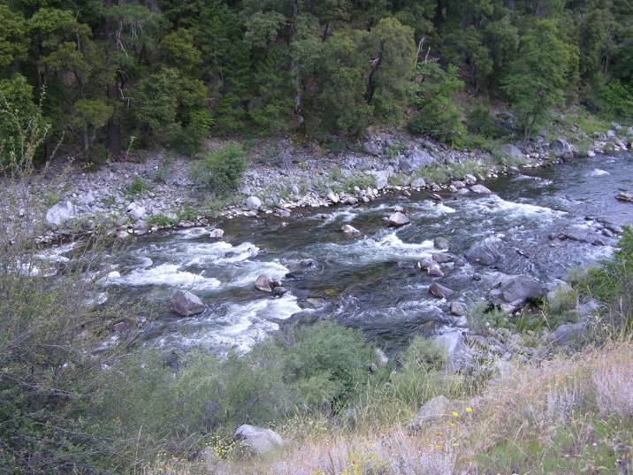
Sources of DO in Aquatic Systems
Algae and other aquatic plants produce much of the DO in aquatic systems.
“Mechanical Aeration” and “Passive Transport” from the air also inject DO into aquatic systems.

Slide 16

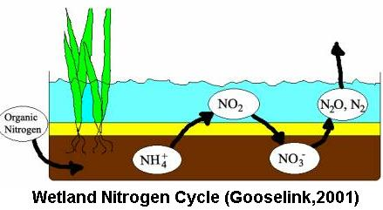
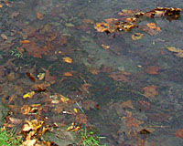
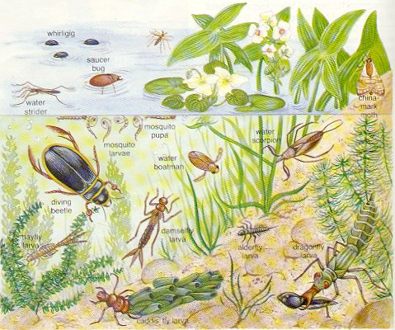
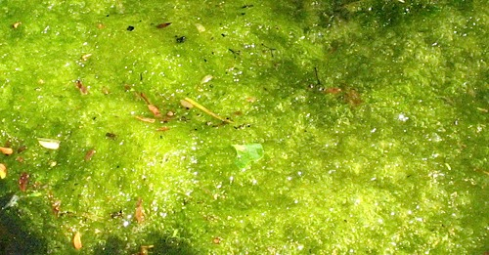
Importance of DO in Aquatic Systems
Chemical Reactions
Fish and Animals
Bacterial / Fungal Decomposition
Insects, Worms, etc.
Algae and Plants

Slide 17
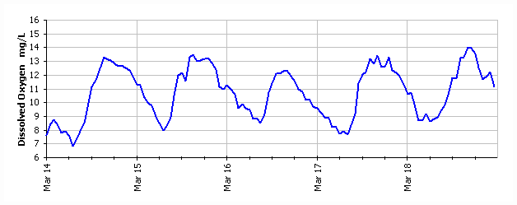
Variability of DO – the Diurnal Cycle
“Diurnal” means a pattern that reoccurs every 24 hours.
Sometimes called “Diel”.
Normally, DO is highest in daylight and lowest at night, following a “sine curve”.
24 h diurnal cycles
~3:00 PM
~6:00 AM

Slide 18
DO and Temperature Effects
Winter
100% Saturation
Summer

Slide 19
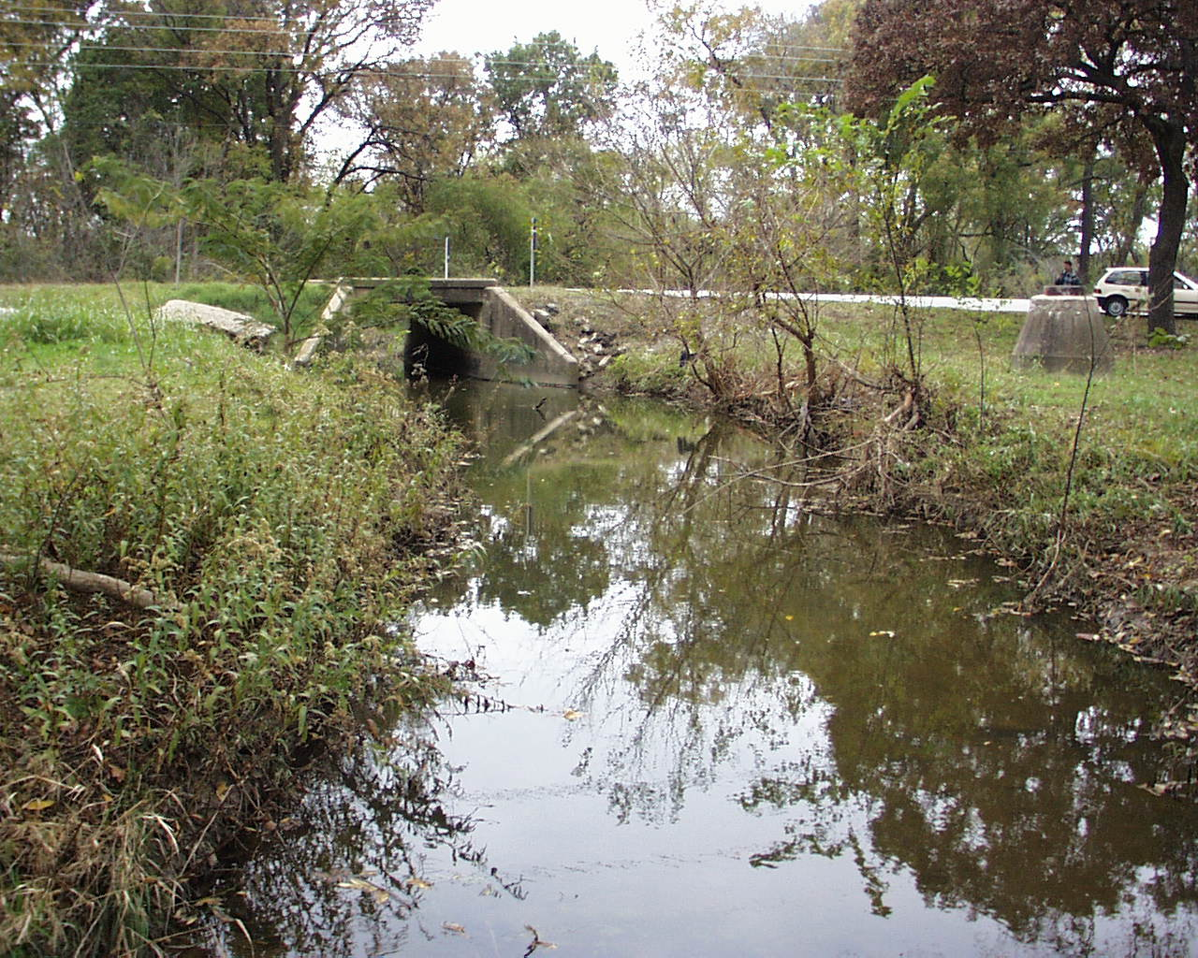
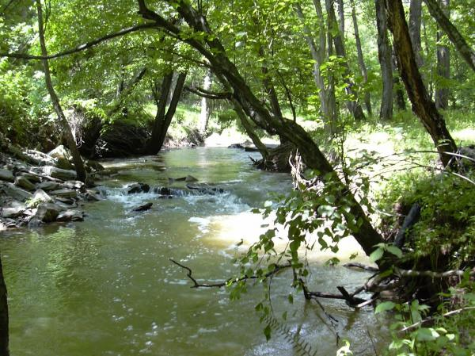
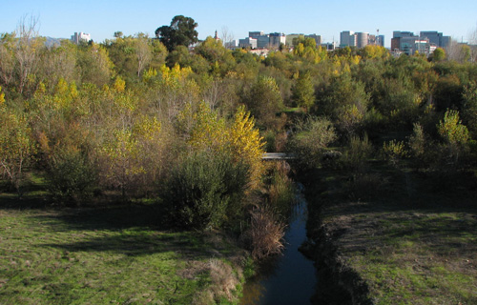
Shaded Streams and Sunlight
Plants need sunlight.
Shaded stream segments have less oxygen production.
Deep shade can significantly reduce algae.

Slide 20
Percent Saturation vs. Concentration
DO data are mostly reported as concentrations in units of milligrams per liter (mg/L) (~ppm)
% Saturation is calculated from DO and temperature.
100% Saturation = maximum amount of DO that can be held.
Algal oxygen production can add >100% Saturation.
> 120% Sat. indicates too much algae.
< 60% Sat. indicates stress for aquatic life.

Slide 21
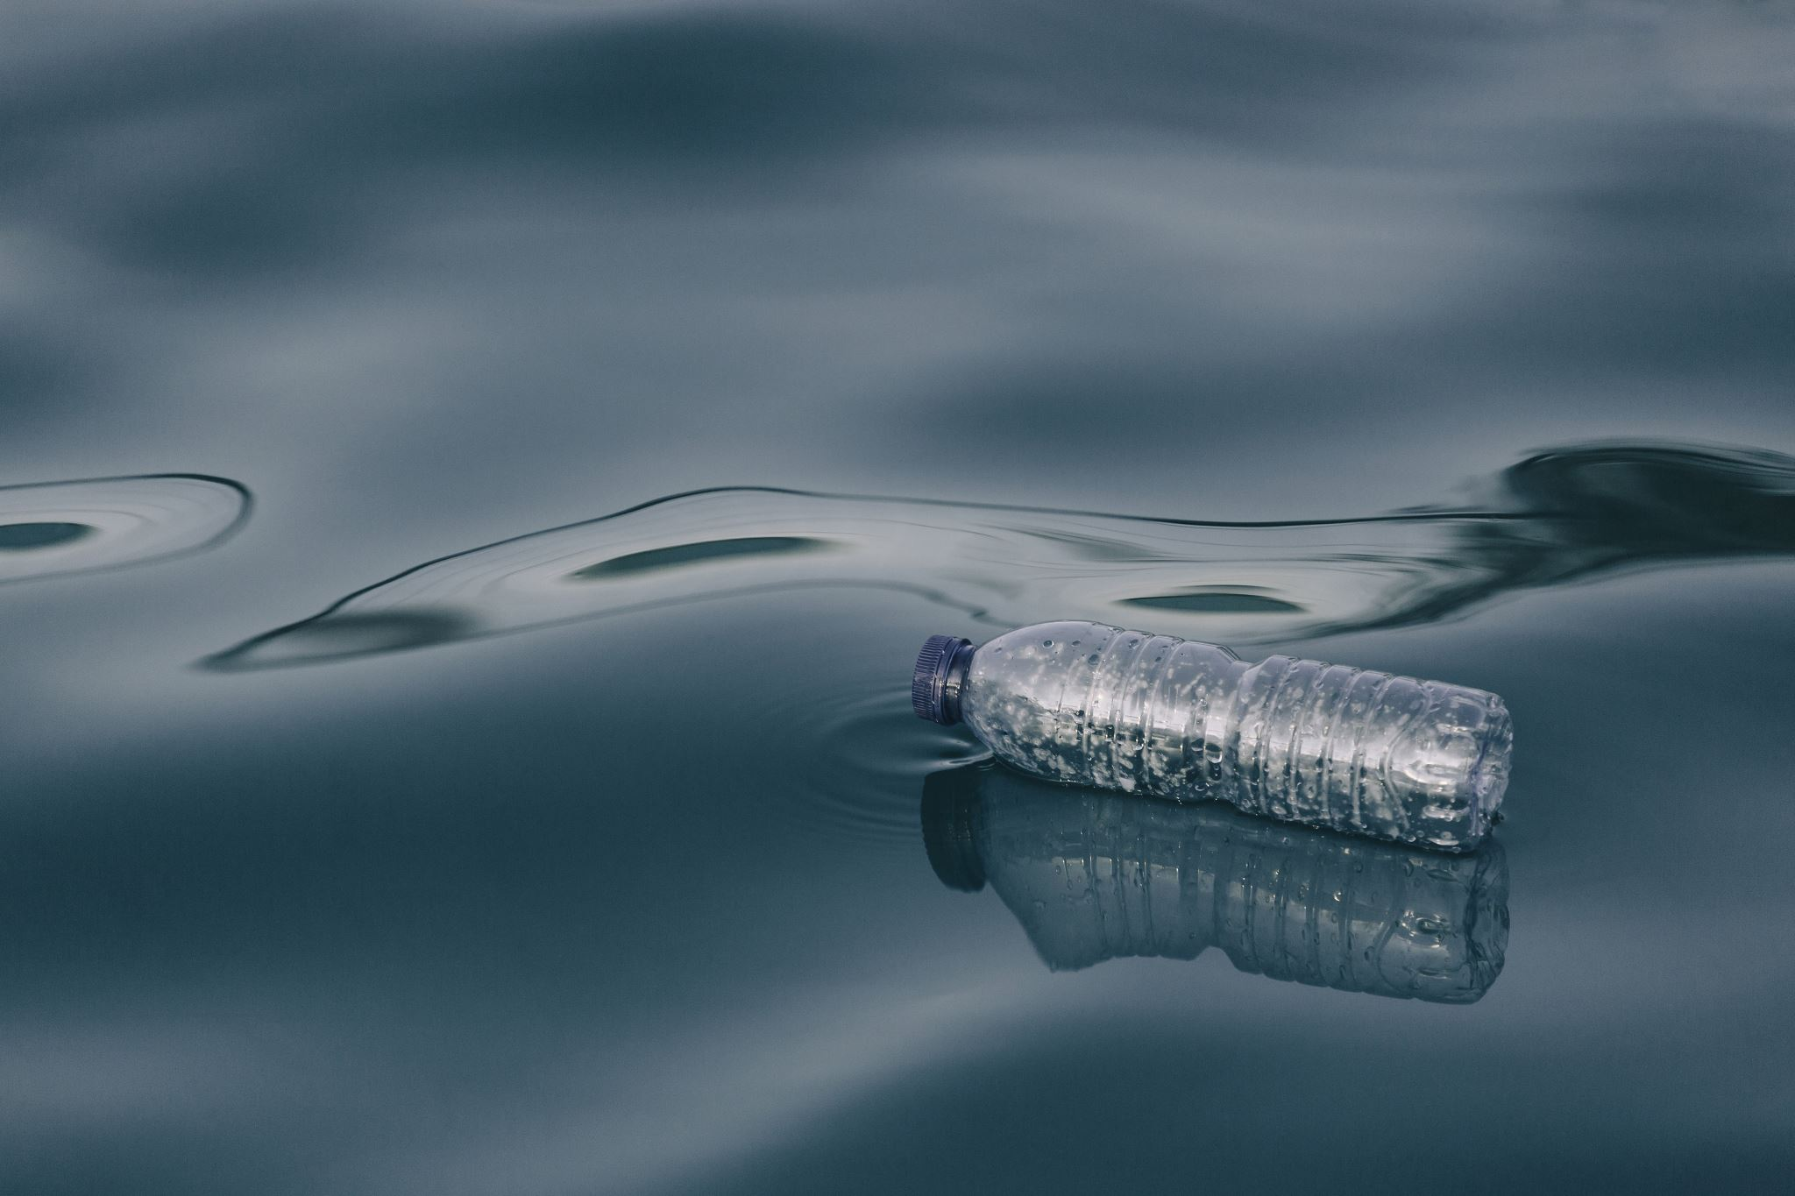
Importance of DO In Stormwater Pollution
A healthy DO range indicates good water quality.
Too much or too little DO indicates a system out of balance.
Stream biota respond immediately to DO imbalances.
DO is used to determine 303(d) stream impairment.
DO stress indicates too much organic waste (BOD), too many nutrients, or too much algae and bacteria.
Prolonged DO depletion results in noxious odors and death of stream biota.

Slide 22
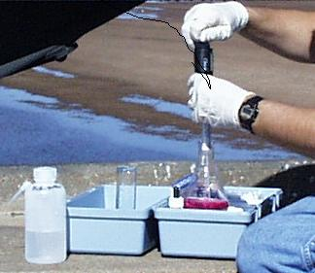
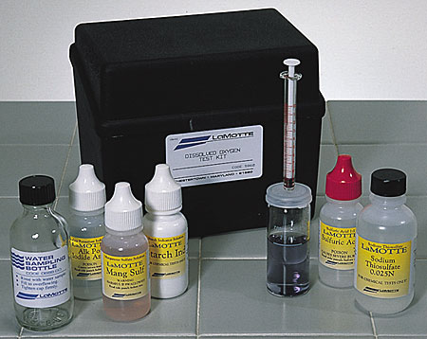
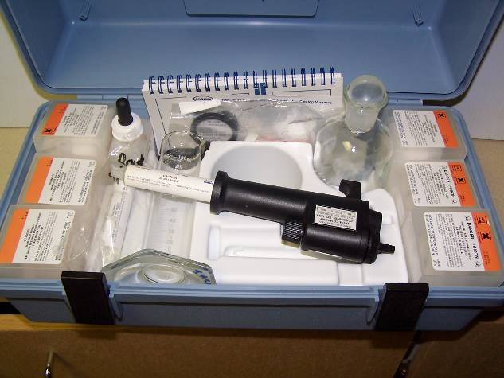
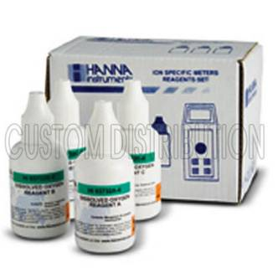
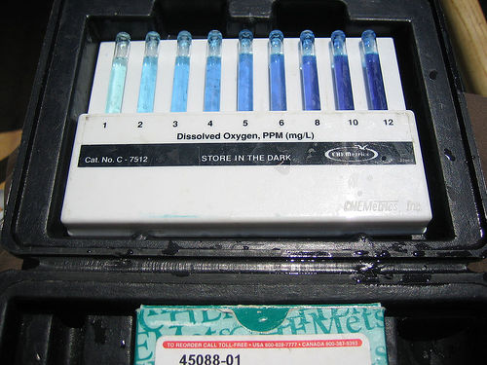
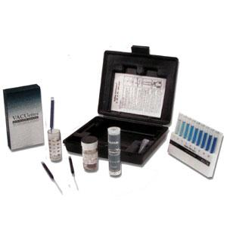
DO Field Testing: Chemical Tests
Titration in the field
Most common is the Winkler Titration
Color intensity test kits (screening only)

Slide 23
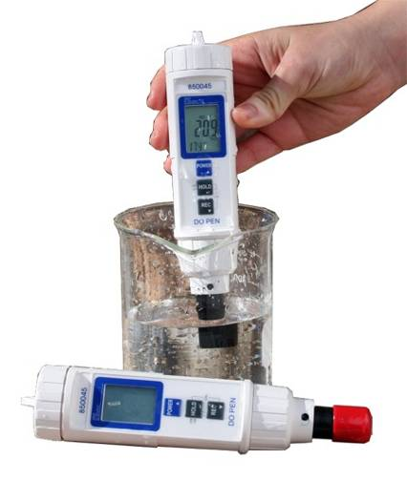
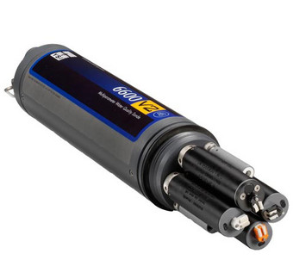
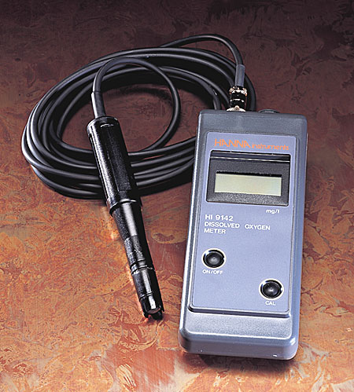
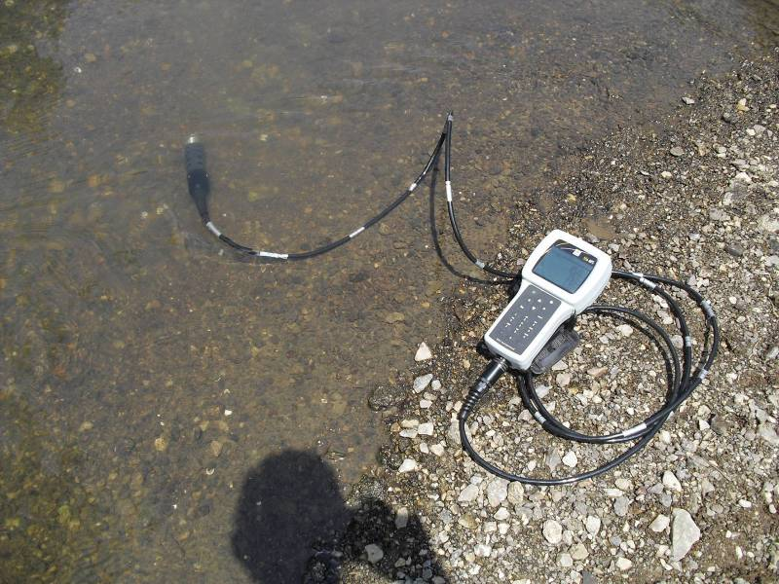
DO Field Testing: Probes & Meters
Single Probe
Multi-Probe Pen / Dip Stick
“Sonde”
Meters must be calibrated.
Expensive, very accurate.

Slide 24
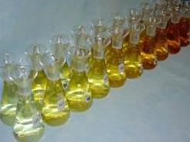
No DO Samples to the Lab
DO in water changes rapidly.
Samples contain algae, bacteria, small organisms that will alter the DO in water quickly.
There is no preservative for DO samples.
Therefore, DO is a field measured parameter.
One exception is Winkler Titration:
“Fix” the Winkler, then take the fixed sample to the lab for titration.
Winkler field fix
Less iodine = lower DO

Slide 25
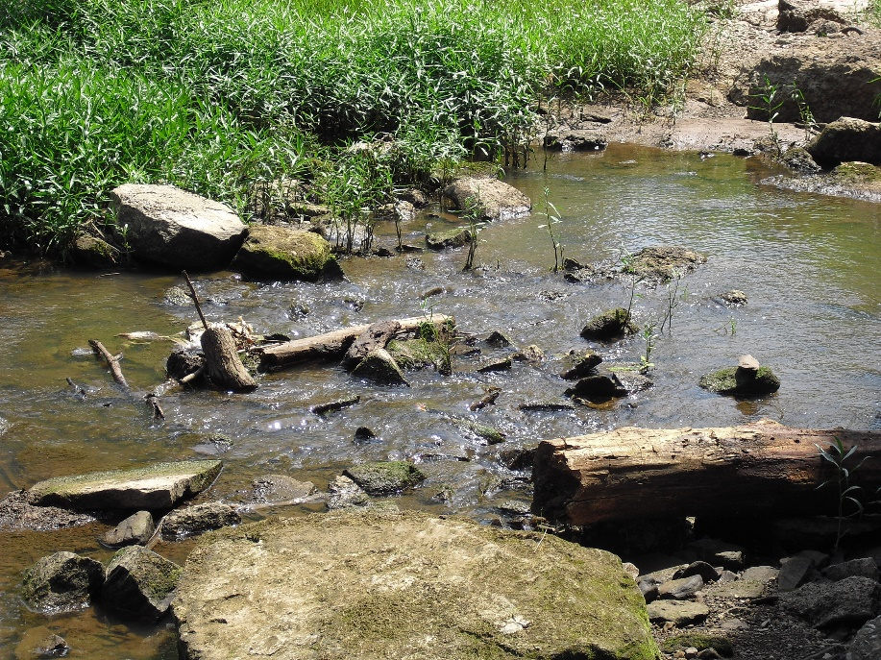
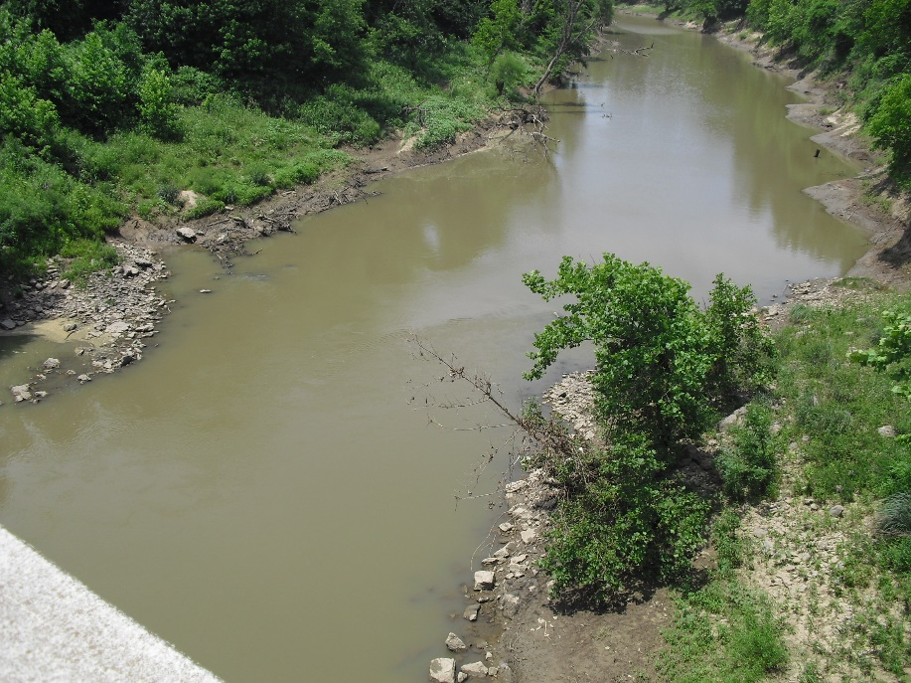
DO Sampling Hint: Representativeness
“Representativeness” ensures that your measurements reflect the stream conditions you are wanting to assess.
Should you sample pools if there is no stream flow ?
RIFFLES are not common; but they add oxygen.
POOLS are common, but they are lower in oxygen.

Slide 26
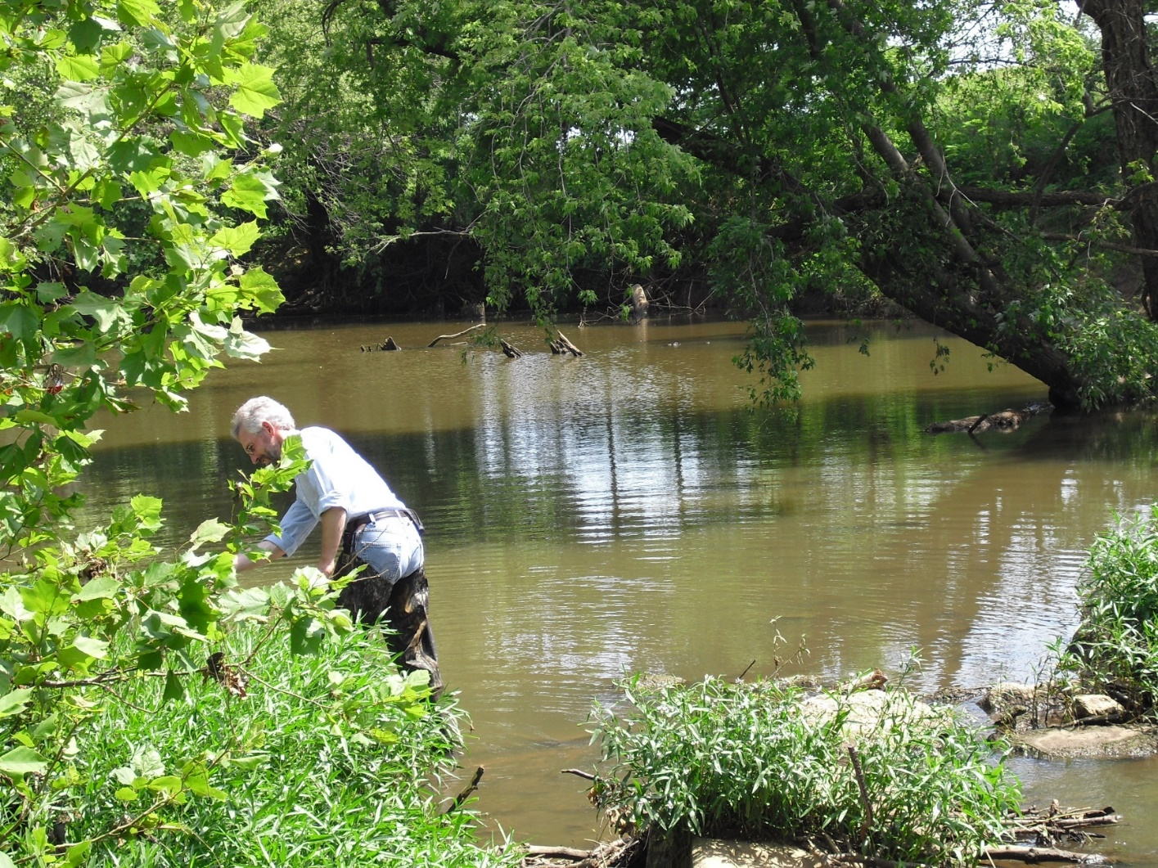
DO Sampling Hint: Stream Banks
Streams have a variety of physical and chemical conditions.
Is this sampling site representative of what you want your data to reflect ?
Will the water next to the bank of this large pool be the same as the water in the pool itself ?

Slide 27
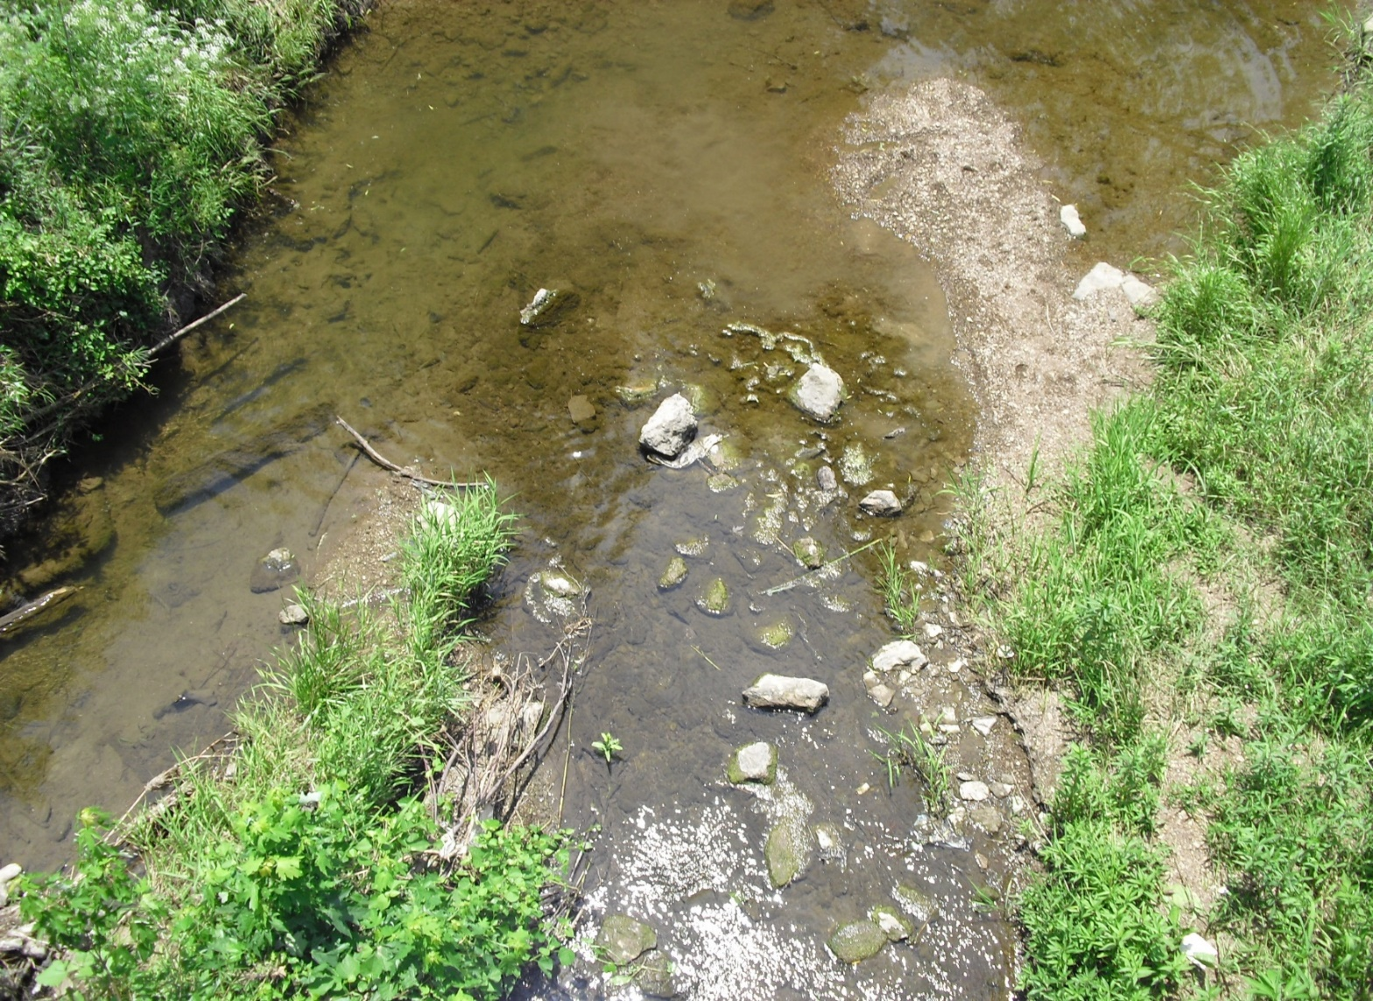
DO Sampling Hint: Periphyton
“Periphyton” is an attached assemblage of algae and other small organisms.
Periphyton adds DO in daytime and depletes DO at nighttime.
In bright afternoon sun, % Saturation can be > 150%.
Is this representative?

Slide 28
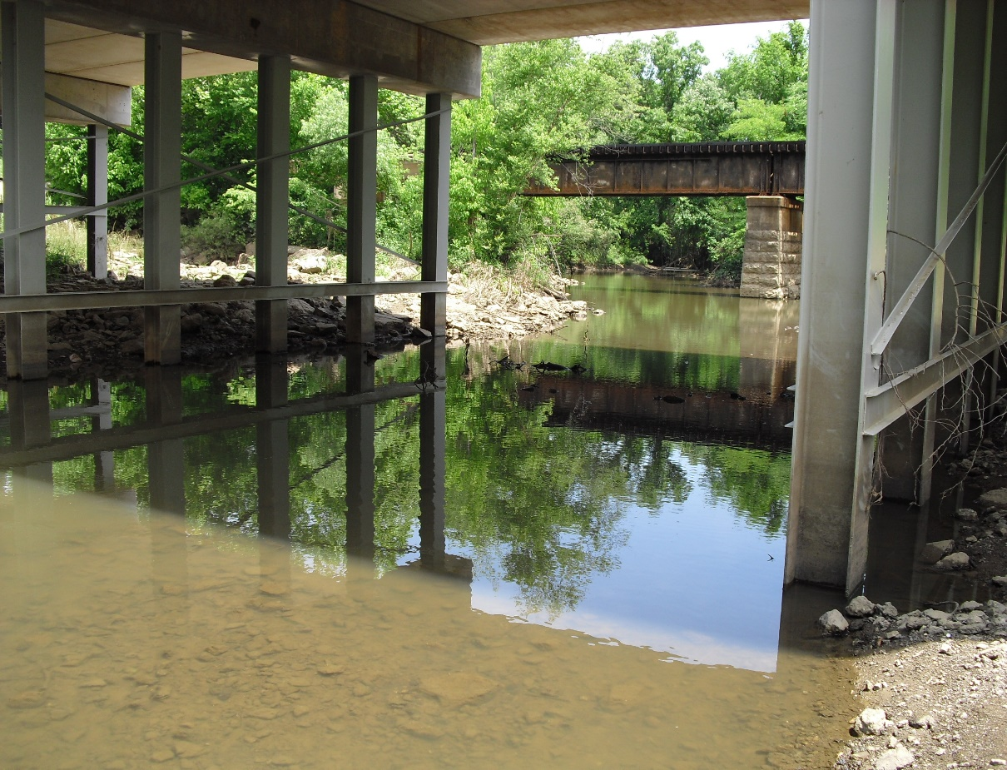
DO Sampling Hint: Bridge Locations
Bridges make safe and convenient sampling sites. Is the stream under the bridge representative?
Bridges are sites of pollution introduction.
Road dusts
Dead animals
Trash and debris
Try to sample on the upstream side of the bridge to minimize contamination.

Slide 29
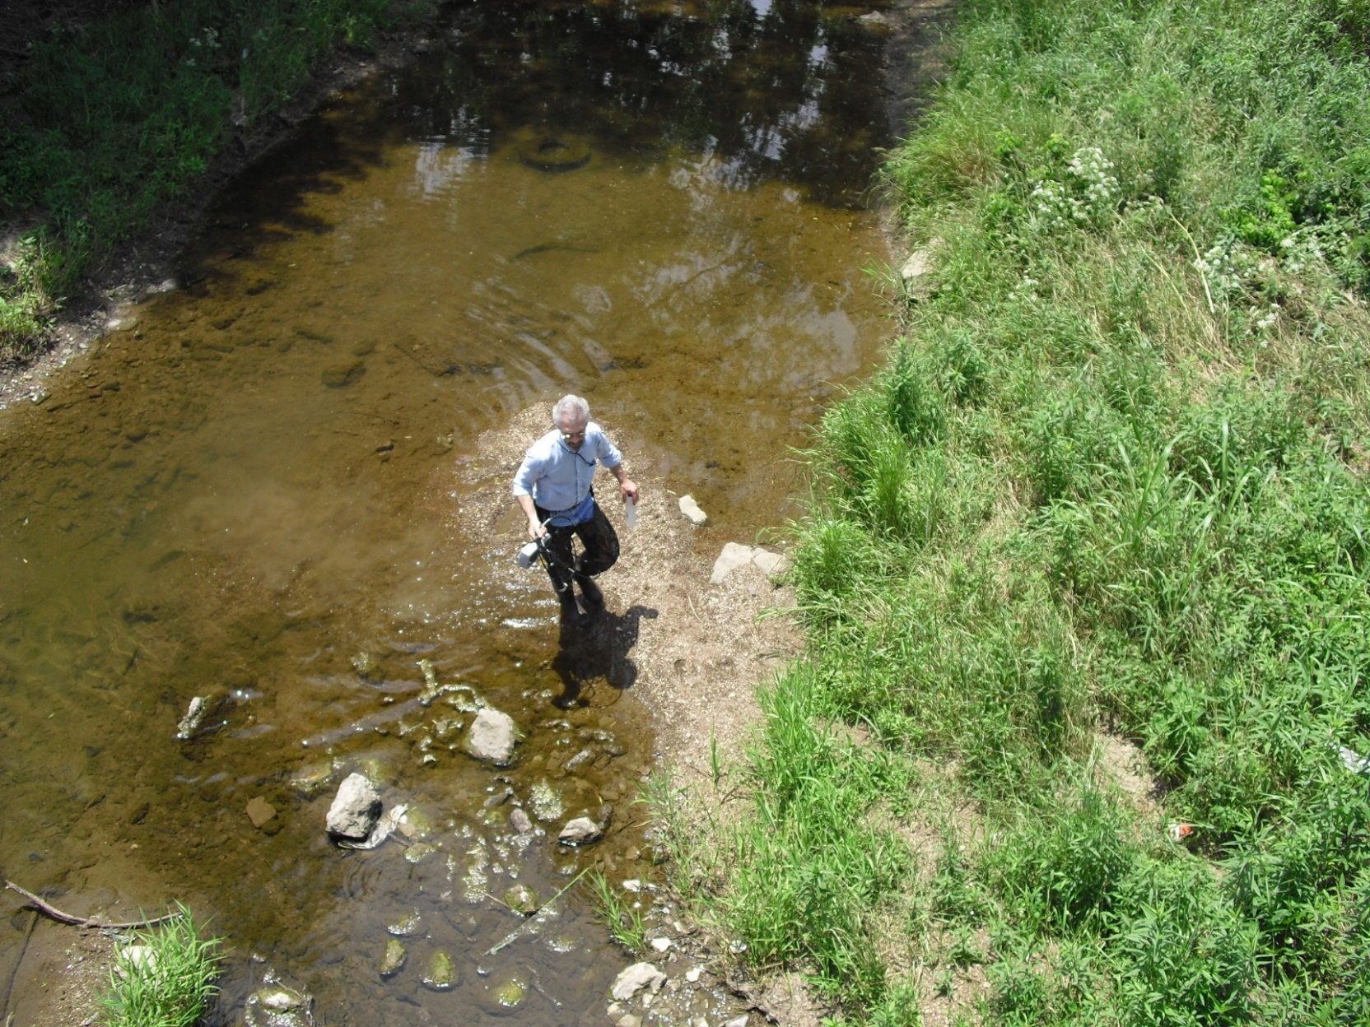
DO Sampling Hint: Wading
Wading stirs up stream bed sediments, contaminates samples and introduces error in field measurements.
Collect samples upstream of disturbed areas.
Wait for current to wash away sediment clouds.

Slide 30
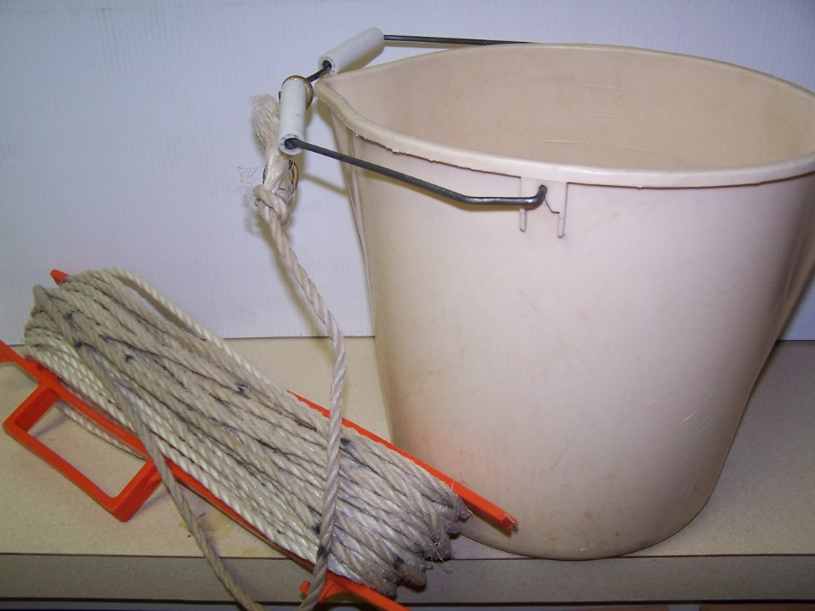
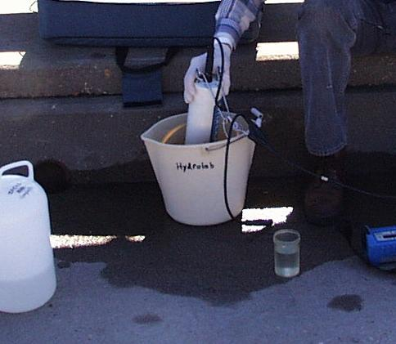
DO Sampling Hint: Bucket Samples
Very convenient from bridges.
Minimize shaking the bucket.
Measure ASAP.
DO in bucket changes quickly !
Most probes and sondes require constant flow.
GENTLY swirl probe in bucket.
Minimize turbulence.
DO changes quickly !

Slide 31
DO Data Interpretation
Time of day (24 hour diurnal cycle).
Time of year (seasonal temperatures, algal growth).
Stream flow (riffles vs. flowing pools).
Non-flowing residual pools (representative?).
Depth of sample in water column.
Concentration vs. % saturation.
Water Quality Standards (seasonal standards).
Periphyton and algae effects.
Organic “muck” and DO “sinks” (representativeness).
Shade vs. sunlight effects (representativeness).
Quality of measurement device and procedures.
Many factors affect interpretation of DO data.

Slide 32
Chemistry and Monitoring of Conductivity

Slide 33
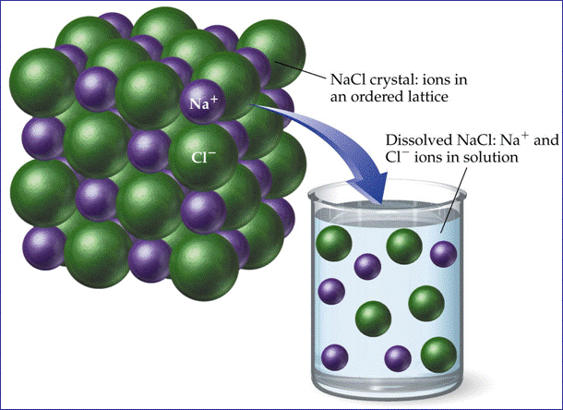
Conductivity in Water Samples
The ability of water to conduct an electrical current is directly related to the total dissolved solids (TDS) in the water that produce positive (+) and negative (-) ions.
Some common ions found are: chloride, nitrate, sulfate, phosphate, sodium, magnesium, calcium and iron.

Slide 34
Converting Conductivity to TDS
The conversion factor (CF) to convert conductivity to TDS varies from about 0.54 to 0.96.
If the conversion factor has not been determined through experimentation, 0.67 is commonly used as an approximation.
TDS (mg/l) = Conductivity (µS/cm) x CF
TDS ÷ Conductivity = Conversion Factor
Unverified CFs are unreliable. Many field meters convert automatically, but be careful using calculated TDS data.

Slide 35
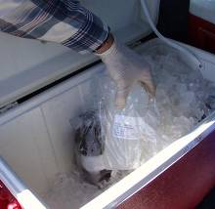
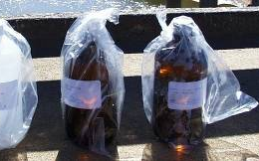
Conductivity Lab Sample Collection
Samples to be analyzed in a lab can be collected in polyethylene bottles (plastic or glass).
Holding time for specific conductance is 28 days if the sample is stored at less than 6° C and not allowed to freeze.

Slide 36
Conductivity Ranges in Samples
Deionized water = 0.5 to 3 µS/cm
Streams and Rivers = 50 to 1,500 µS/cm
Industrial water = as high as 10,000 µS/cm
Fresh water with a good mix of fisheries generally ranges from 50 to 500 µS/cm.
Conductivity outside the fresh water range could indicate that the water is not suitable for certain macroinvertebrates or species of fish.

Slide 37
Conductivity of Surface Water
Specific Conductance Measured on 6-2-2010
River/Creek | Location | µS/cm
Bird Creek | 46th St. North, Tulsa | 444
Bird Creek | 56th St. North, Tulsa | 346
Caney River | W3500 Road | 400
Cat Creek | Muskogee St., Claremore | 702
Cat Creek | Ramm Rd., Claremore | 656
Dog Creek | SH 20, Claremore | 266
Dog Creek | SH 88, Claremore | 228

Slide 38
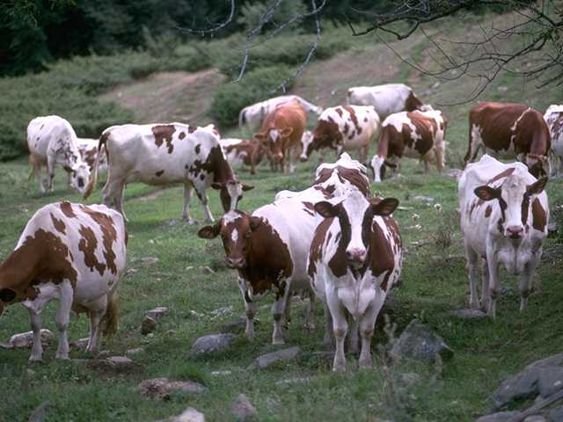
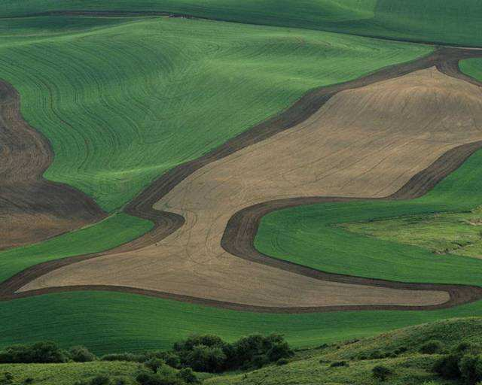
Possible Source Tracking Applications
Groundwater often contains a lot of salts and minerals, which can give groundwater a higher specific conductance.
Agricultural runoff can increase conductivity in receiving streams due to phosphates, nitrates (nutrients), salts and minerals in the runoff.

Slide 39
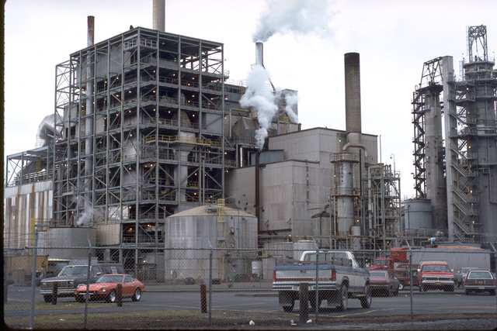
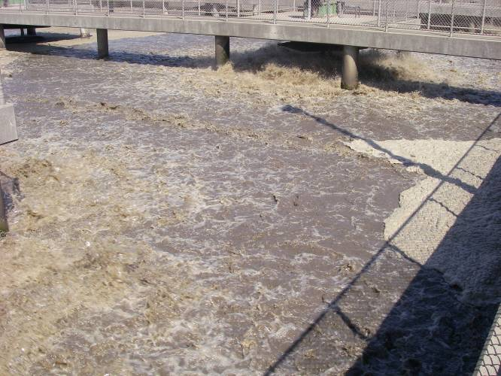
Possible Source Tracking Applications
Some industrial process waters and runoff from industrial sites may have high conductivities.
Wastewater from treatment plants and onsite treatment systems can raise conductivity due to high TDS concentrations.

Slide 40
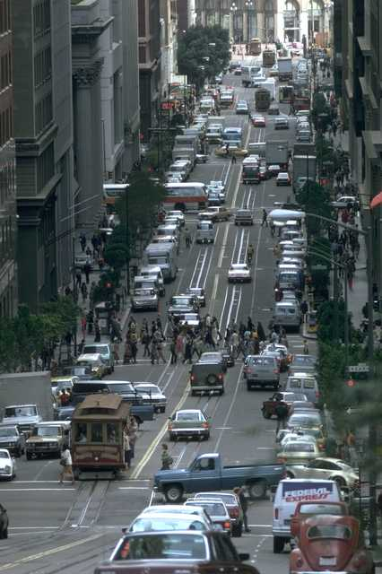
Possible Source Tracking Applications
Urban runoff from roads can raise conductivity, especially if salts and deicing materials have been used.
Streets and their stormwater collection systems collect runoff from many areas that contain a wide variety of salts, fertilizers, and illicit discharges, all of which increase conductivities in receiving streams.

Slide 41


And… That’s all, folks !

Slide 42



Questions ?
Vernon Seaman
Manager, Envir. and Energy Planning
INCOG
Two West 2nd Street, Ste 800
Tulsa, OK 74103
(918) 579-9451
vseaman@incog.org

